Slide 1
http://library.nics.gov.uk

Slide 2
NICS Library Service
Launched July 2016
Amalgamation of Libraries and staff
Main Libraries in Dundonald House & Victoria Hall
Victoria Hall Library – legal collection as well as general NICS material

Slide 3
What we do?
Provide an information and enquiry service
Lending service
Access to electronic databases
Access to e-books
Training on NICS e-Library databases

Slide 4
How to access NICS e-Library
From desktop icon
NICS e-Library website: http://library.nics.gov.uk
Legal enquiries – legal.library@finance-ni.gov.uk
Visit the Library
By telephone

Slide 5
Electronic Resources
Journal Databases including: Science Direct, EBSCO, and Emerald providing access to popular journals like Public Administration and Harvard Business Review
Access to newspapers via the Nexis service
Financial Times and the Economist online
Lexis Legal Library
Valentine’s Laws of Northern Ireland
E-Books

Slide 6
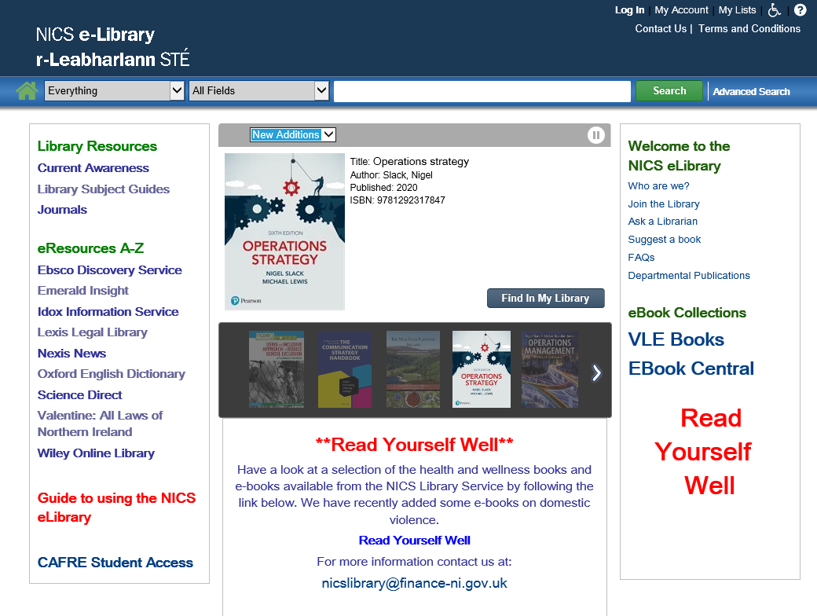

Slide 7
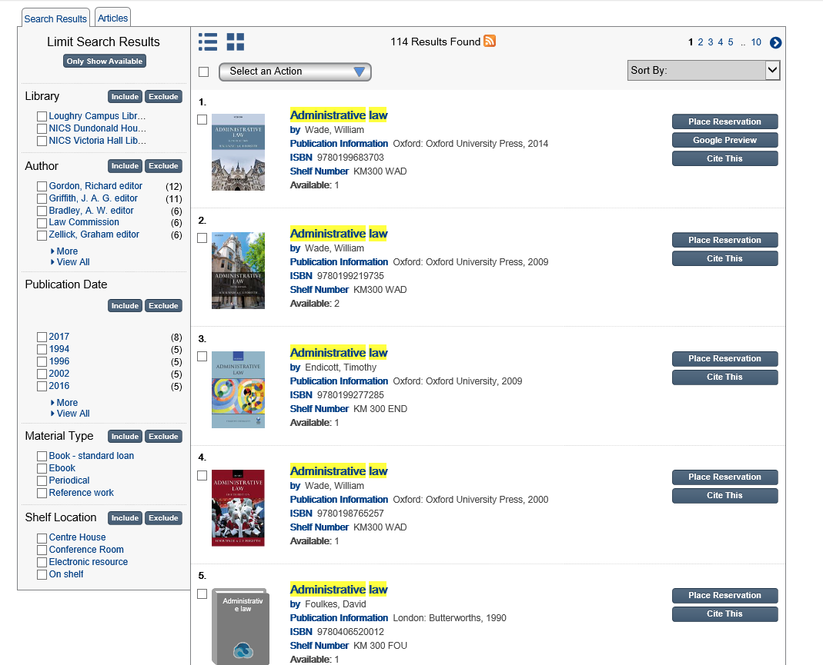

Slide 8
Legal Information Online Network
Government legal community information gateway
https://lion.governmentlegal.gov.uk
Provides access to:
Westlaw
Lexis
LexisPSL
Lawtel
Justis One
Practical Law
Notes:
Lion is simply a intranet site with a wealth of useful information across all legal topics with government.All government lawyers can register with LION and access this wide range of relevant information and contacts.
There is also an added LION subscription service which rpvides access to a package of 6 databases for those who have a relevant licence.There are currently 55 user licences to this list of databases within DSO. New contract starting in April and we are hoping to increase the number of licences available. We need to give our number tomorrow so make sure that you let your line manager know that you need access and get your name on the list.

Slide 9
Westlaw/Practical Law
Notes:
One Pass login to access Practical Law, Westlaw and Westlaw books
Click on Remember Me first time you login
DPP have also a subscription to Westlaw and this is a lower level of access than DSO. If you hover over the icon of a head beside Account – your name should appear confirming that you are in the LION subscription ok.

Slide 10
Westlaw
Notes:
See the tabs with cases, legislation, journals, current awareness, eu etc.
You can browse from the list of topics
See also Favorites, folders, history and alerts tab at the top

Slide 11
Westlaw - cases
The most comprehensive case finding database available for case law
Highlights significant cases and guidance cases
Each case contains a case analysis, a full judgement and cited/citing references, links to journals and books and links to relevant Practical Law
Delivery options, pdf version, add to folder, annotations and case alert/tracking
Status icon (positive/negative judicial consideration)and link to Graphical History
Notes:
Significant case sets out a new legal principles, extends the law, applies established principles to a new situation, overturns established legal authority, interprets or defines statutory and non-statutory words or phrases, or is stated by the judge to be of general public importance
Guidance case – if it gives legal or procedural guidance or reinforces or explains existing guidance.
Status icon – positive/negative judicial consideration

Slide 12
Westlaw - legislation
Consolidated legislation, including Northern Ireland
Bills & draft legislation including devolved Parliaments and Brexit content
Policy and guidance material including consultations and codes of practice
Information for each piece of legislation includes commentary and Practical Law references; analysis including commencement information, extent, definitions, SIs made under and citing references
Legislation compare tool which allows you to compare 2 versions of a legislative provision – marking up the difference (historic and prospective)

Slide 13
Westlaw - journals
Over 100 full-text journals and access to abstracts of every article in every English-language legal journal in Europe
In the journals search click on the More option to search by additional fields including case/legislation cited
You can also select a specific journal and browse by year/issue

Slide 14
Westlaw – more
Current Awareness – search and browse the latest developments by topic and document type
EU information -cases, legislation, treaties, information and notices
Index of Legal terms – search for definitions in legal dictionaries and in Westlaw UK’s cases, legislation and journals
News – opens in a new page and includes UK and some NI newspapers
Westlaw books – Books and looseleafs on a variety of practice areas, e.g. Clerk and Lindsell on Torts, Phipson on Evidence and De Smith’s Judicial Review

Slide 15
Practical Law

Slide 16
Practical Law
A maintained library of materials on a wide range of practice areas, such as public, employment and commercial law
Useful to get up to speed quickly on areas of law outside your specialism
Includes Practice Notes, Checklists, Legal updates and Standard documents
Articles written by experts on legal developments
Integrates to Westlaw UK cases and legislation

Slide 17
Lexis Library
Notes:
My Bookshelf can be personalised to include your favourite sources.
Similar tabs to Westlaw

Slide 18
Lexis Library
NICS Lexis – Cases, legislation and journals. IP recognition so no password required from NICS Library homepage
LION Lexis subscription – Cases, legislation and journals as well as commentary and forms and precedents. Password required
Commentary titles include Halsbury’s Laws of England, Halsbury’s Statutes and Encyclopedia of Forms and Precedents
Includes transcripts of unreported cases from the mid 1980s and is a good source of NI case law
Notes:
There are two accesses to Lexis Legal Library –NICS and DSO LION.

Slide 19
LexisPSL

Slide 20
LexisPSL
Access LexisPSL in one of 2 ways:
Via the link (LexisPSL (Practical Guidance))on the far right of the General Search page in LexisLibrary when already signed in;
Access it directly at www.lexisnexis.com/uk/lexispsl and sign in using your LexisLibrary details
Select the relevant practice area by clicking on the arrow beside the current practice area, e.g. Employment
The Topics menu lists the wide range of subjects covered in the chosen practice area
There is also a search box to allow the user to search all practice areas or select only relevant areas

Slide 21
Lawtel
Notes:
From Thomson Reuters – abbreviated Westlaw

Slide 22
Lawtel
Essentially a current awareness service that provides brief case reports within a day of judgement being made
Daily or weekly alerting service on a specific topic
Library currently emails some, e.g. criminal justice, environment, family and social security
Contact us for full text of articles
Full text UK legislation

Slide 23
Justis One

Slide 24
Justis One
The UK Statutes database contains the full text of all Acts of Parliament in England, Wales and Scotland as enacted, from 1235 to the present day
Local Acts - A fully searchable database of all as-enacted, full-text local legislation from 1797 to date
UK Case law from 1163 to the present day
Contains Irish legislation and cases from 1998
Notes:
Useful for old legislation. May not be totally comprehensive

Slide 25
Further Training
Each of the LION databases have their own easy to follow User Guides and tutorials on their site
You can arrange one to one training sessions with library staff
Suppliers regularly offer workplace visits for training seminars
If you require further information on any of the library services or databases please contact us:
Fiona Sawey – x41046
Gillian Potter – x51224
legal.library@finance-ni.gov.uk

