Slide 1
An Introduction to The Knowledge Exchange
Rebecca Jackson
Research and Training Manager

Slide 2
What’s on the agenda?
An introduction to the service
Database demonstration
Q&A

Slide 3
What is The Knowledge Exchange?
A leading source of public sector information in the UK
A subscription library that has been built up over 40 years- formerly known as the Planning Exchange
Covers a range of different economic and social policy areas
Provides evidence to help support decision making; meeting, report and briefing preparation; specific project work; keeping up to date; and CPD
Members across diverse sectors spread across the UK including central government, local authorities, consultancies and voluntary organisations

Slide 4
What can I find on the database?
Searchable database and full bibliographic records for over 200,000 policy related resources
Bespoke abstracts for each record highlighting key information, recommendations and case studies
Electronic access to documents where possible, hard copies can be requested direct from the team where electronic access is not available
Available 24/7 and updated daily
Google style standard search, advanced search filtering and other tools, including exporting results and saving searches
Exclusive briefings written by our team

Slide 5
Example abstract
Ref No: B55796
Vorushylo, Inna et al
Zero-in on NI-heat: pathways to heat decarbonisation in Northern Ireland
UK Energy Research Centre (UKERC), 58 Prince's Gate, Exhibition Road, London, SW7 2PG
(Report available on the internet at: http://ow.ly/QbDB30r1QzP)
2020 Pages: 67 Price: na ISBN:
Explores pathways towards heat decarbonisation in Northern Ireland (NI) drawing on the output from four stakeholder engagement workshops and a seminar. Presents a heat sector overview of NI noting that it contributed 4% of total UK carbon emissions in 2016. Examines the barriers and opportunities for heat decarbonisation looking at energy policy and regulation, technology-specific and operational barriers, consumers, the public and commercial sectors, and infrastructure barriers. Considers that NI’s heat decarbonisation could be achieved by a combination of different technological solutions such as bio-energy, heat networks and repurposed gas networks. Reports on experts’ and consumers’ perceptions of heat decarbonisation. Finds that the experts support a new strategic framework supporting heat decarbonisation in NI. Considers that there is a necessity for retrofit programmes and strict building regulations for new houses. Concludes that many NI citizens are ready to help the environment and take part in the heat decarbonisation transition.

Slide 6
Governance
Public Services
Emergency planning and resilience
Regeneration
Older people
Crime, justice and rights
Community
Housing
Equality and diversity
Cities
Local Government
Devolution
Economic development and growth
Our subject coverage
Building and construction
Employment
Energy
Transport
Town and country planning
Infrastructure
Environment
Arts and culture
Brexit
Education
Careers
Organisation and management
Training and Skills
Finance and Funding
Planning
Third Sector
Health and social care
Social inclusion
Smart Cities
Children and Young people
Climate Change
Digital infrastructure
Social Inclusion

Slide 7
Current awareness
Weekly Bulletin – selection of latest content added to the database in all policy areas
Fortnightly Topic Updates – everything added to the database in the previous 2 weeks in specific policy areas – 37 to choose from
Personalised alerts – get alerts on any policy topic that you are interested in. Type a search term and save – for example, “dementia”, “Universal Credit”, “homelessness”

Slide 8
Ask a Researcher
Research officer support available 9am-5.30pm, Mon-Fri
We will search the database and other resources for you and send on references and a summary highlighting key findings, trends and useful resources
You can call us on 03330111694, or email AskTheResearchTeam@idoxgroup.com

Slide 9
Summary of benefits
We provide the intelligence and support that researchers, practitioners and professionals need every day.
Learn from best practice case studies and examples of policy implementation from across the UK, Europe and internationally.
Information and intelligence to support improved decision making
Prevents information overload and helps provide wider context to your work in a convenient and efficient way.

Slide 10
Getting Started

Slide 11
Register for a username and password under your organisation’s profile at http://informationservice.idoxgroup.com/iii/Register.do
You can then:
Select Topic Updates to subscribe to on the website via the online form
Email AsktheResearchTeam@idoxgroup.com to add your name to the Bulletin mailing list
Search the database and create personal email alerts

Slide 12
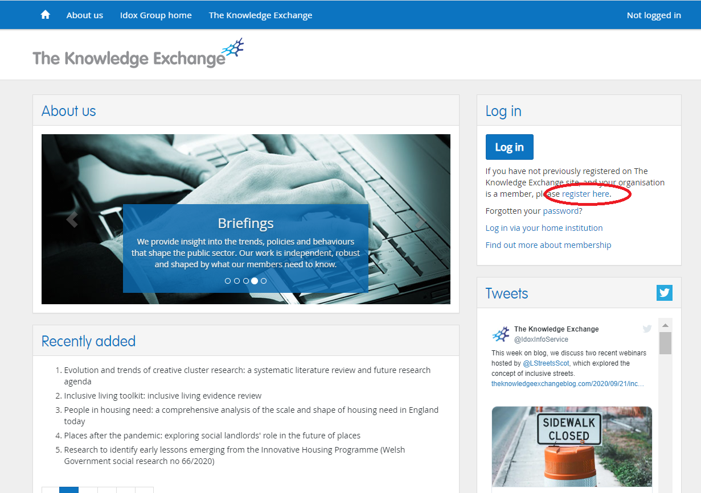
Registering for the service (Step 1) The first time you use the service you will need to register for a username and password

Slide 13
Registering for the service (Step 2) Under the section “Register as a user for an existing profile” select your organisation from the drop-down menu Fill out your personal details and create a username and password, and then click register. Your registration will need to be approved by your organisation’s Profile Manager. You will receive a confirmation email once your registration has been approved

Slide 14
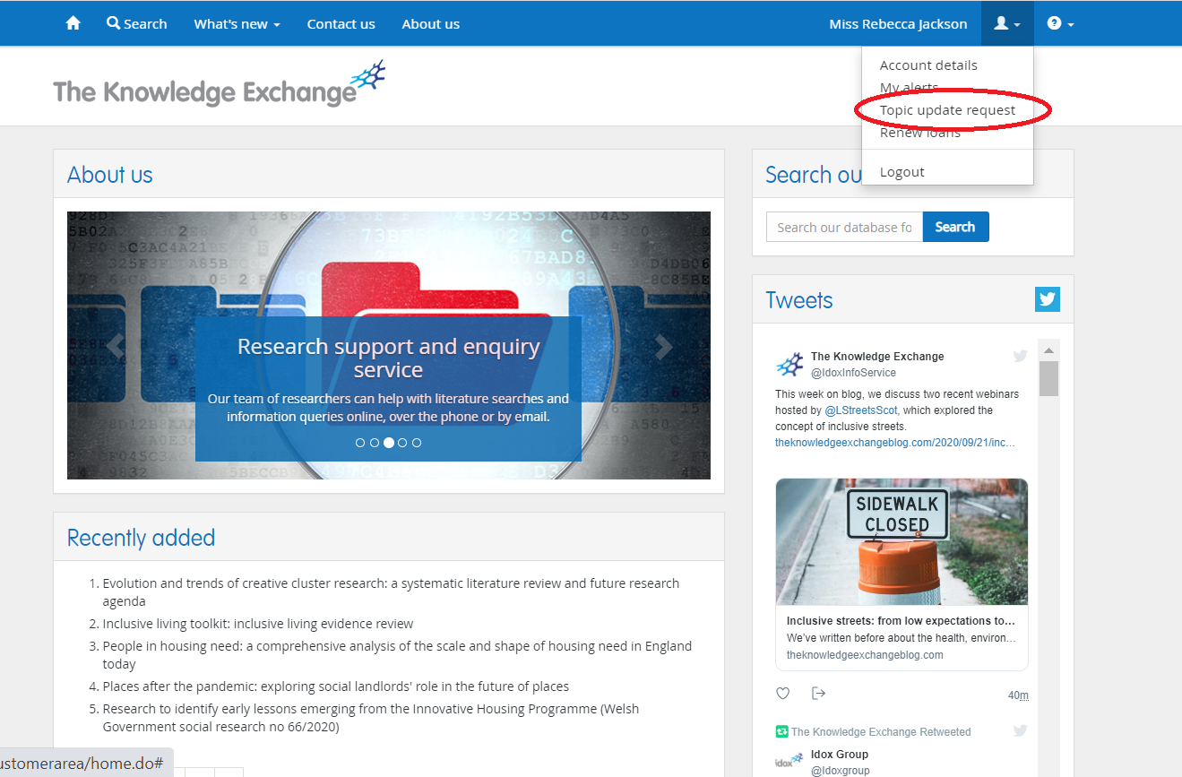
Requesting Topic Updates (Step 1)

Slide 15
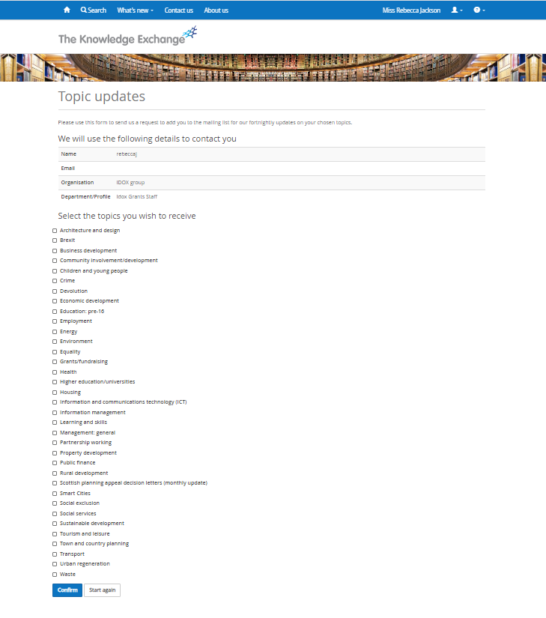
Requesting Topic Updates (Step 2) Select the Topic Updates you wish to subscribe to by clicking the corresponding tick box and then clicking “confirm” You can sign up to as many or as few as you would like, there is no additional cost To register to receive the Weekly Bulletin, please email AskTheResearchTeam@idoxgroup.com

Slide 16
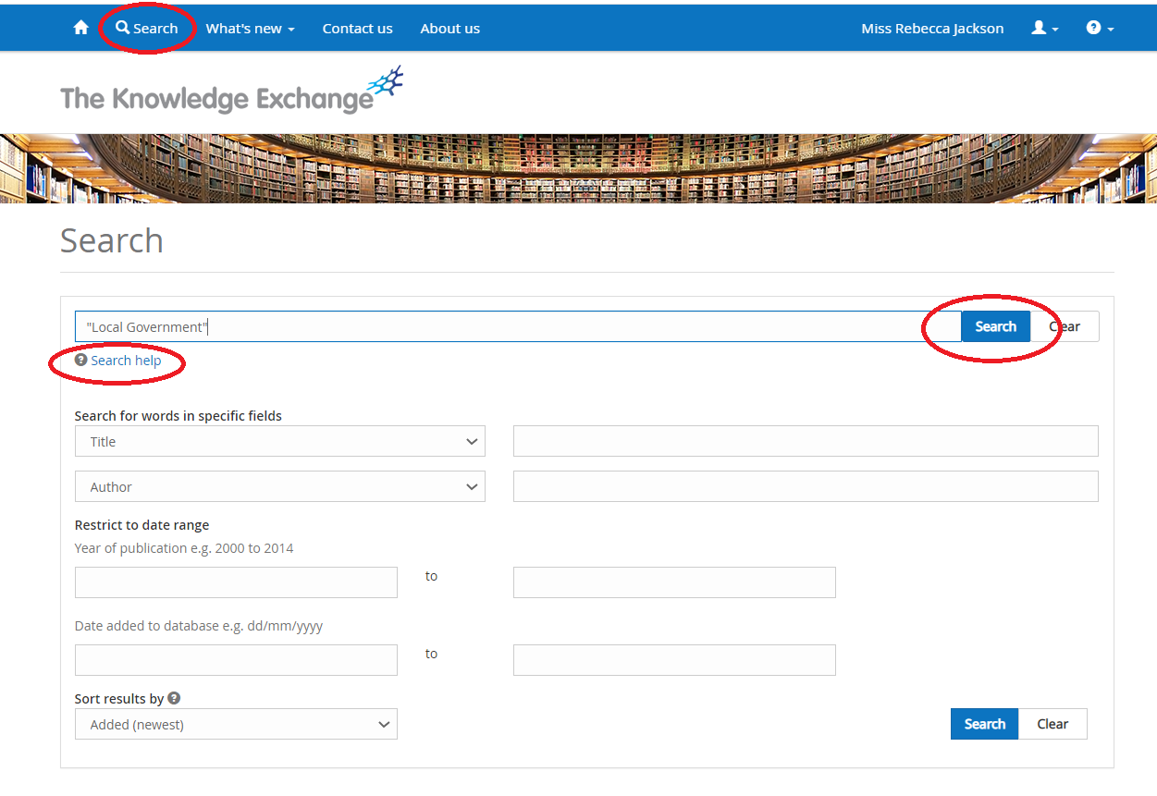
Creating saved search alerts (Step 1) Access the search function of the database by using the “search” tab at the top of the page Type search terms into the main search bar, this will search across all fields and yield the most results Click search to run the search For more detailed help and advice on searching the database, including advanced searches and filtering please consult our “search help” guide or contact a member of the research team

Slide 17
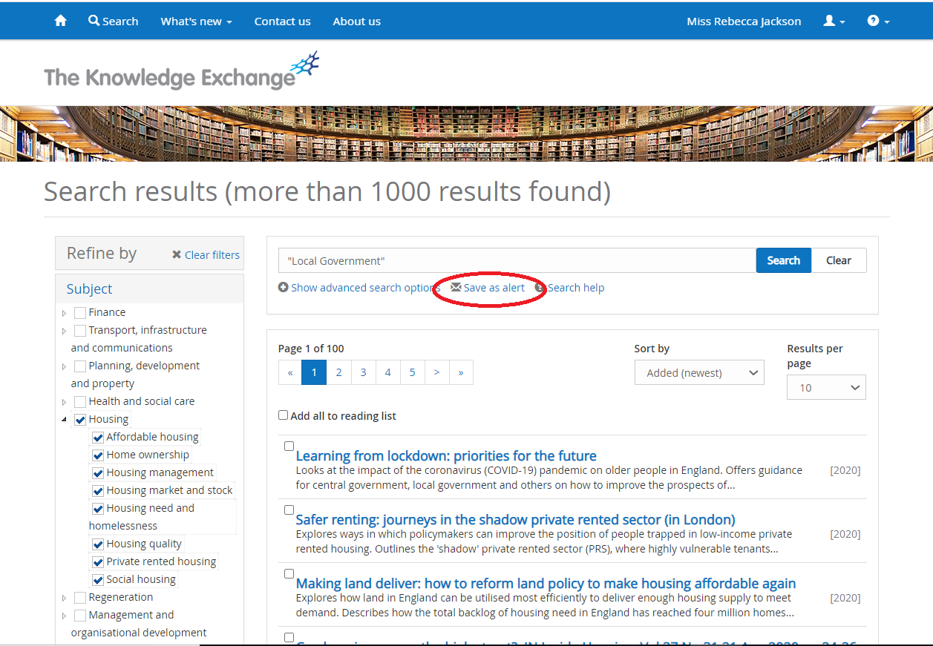
Creating saved search alerts (Step 2) In the search results page to save your search click the “save as alert” link below the search bar. From there you will be prompted to give your alert a name and select the frequency you want the search engine to run the search

Slide 18
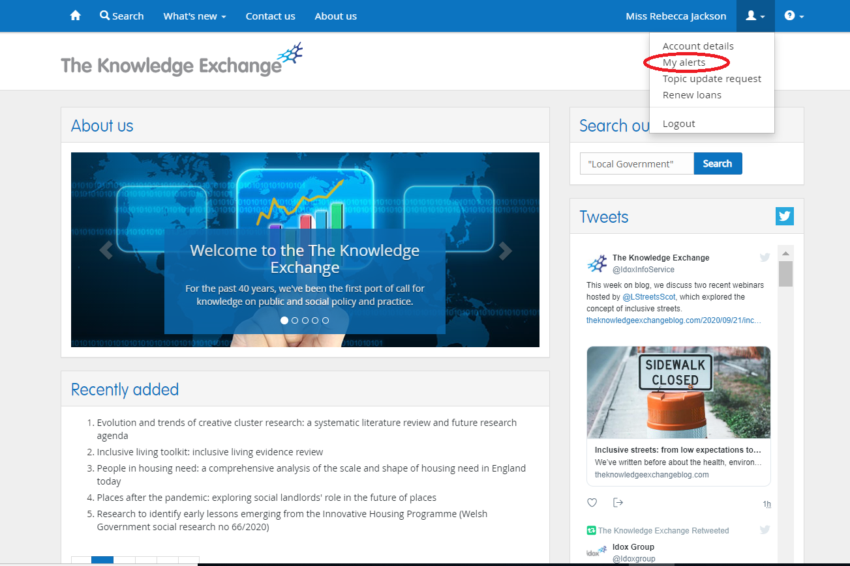
Viewing saved alerts (Step 1)

Slide 19
Viewing saved alerts (Step 2) From this screen you can view your saved searches, manually run your searches and edit your searches.

Slide 20
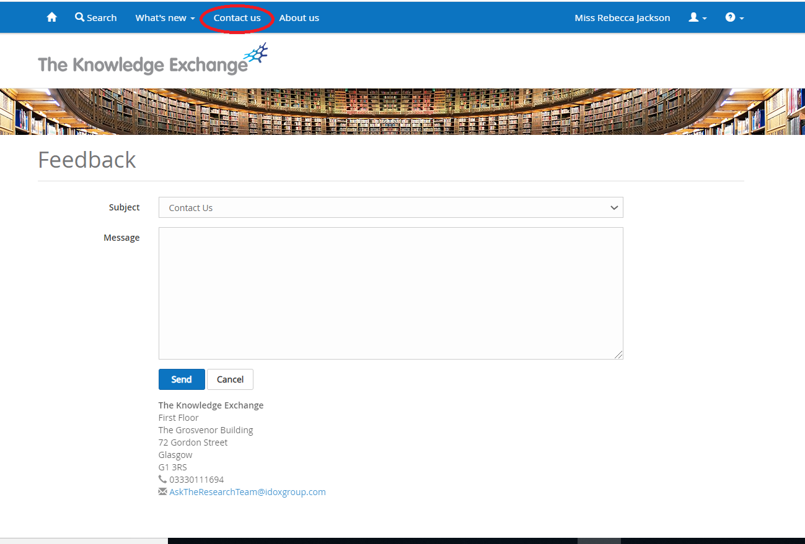
Contact Us If you have any questions or would like advice on searching the database or help signing up to any of our current awareness services, there is a contact us form on our website.

Slide 21
Thank you!
If you have any questions after this session, please get in touch or consult the “user guides” on The Knowledge Exchange website
rebecca.jackson@idoxgroup.com – 03330146825
We’re on Twitter: @IdoxInfoService

