Slide 1
The Knowledge Exchange
Rebecca Brisbane, Membership Manager

Slide 2

Agenda
An introduction to TKE
  What The Knowledge Exchange?
  What topic areas does the database cover?
  An overview of our current awareness updates
Searching the TKE database
  An introduction to searching
  Live time demonstration of our library catalogue via
  our website
Q&A

Slide 3

What is The Knowledge Exchange?
A leading source of public sector information in the UK
A subscription library that has been built up over 40 years- formerly known as the Idox Information Service
Covers a range of different economic and social policy areas
Provides evidence to help support decision making; meeting, report and briefing preparation; specific project work; keeping up to date; and CPD
Helps understand how wider policy could impact projects and provides context to help you better understand the policy and evidence landscape
Members across diverse sectors including central government, local authorities, consultancies and voluntary organisations

Slide 4

What we do
Source and summarise research and policy from a broad range of resources to add to our database
Guides and briefing papers
Social media, including our blog
Bespoke enquiry service
http://theknowledgeexchangeblog.com/ @IdoxInfoService

Slide 5

What can I find on the database?
Searchable database and full bibliographic records for over 200,000 policy related resources
Bespoke abstracts for each record highlighting key information, recommendations and case studies
Available 24/7 and updated daily
Google style standard search, advanced search filtering and other tools, including exporting results and saving searches

Slide 6





Some key themes
Governance
  Devolution; Procurement; Local governance
Transport
  Active Travel; Infrastructure development; Transport planning
Housing and planning
  Urban design and regeneration; Retrofit; 20-minute neighbourhoods
Economic development
  Levelling up; Regional growth; inclusive growth
Education and Skills
  Pre-16 education; Apprenticeships; skills planning; reskilling
Environment
  Biodiversity; SUDs; Air quality; Net zero
Employment
  Labour market; unemployment initiatives; economic inactivity; welfare and pensions

Slide 7

Keeping you up to date
Weekly Bulletin – selection of latest content added to the database in all policy areas
Fortnightly Topic Updates – everything added to the database in the previous 2 weeks in specific policy areas – 35 to choose from
Personalised alerts – get alerts on any policy topic that you are interested in. Type a search term and save – for example, “Active travel”; “Night-time economy”; “Inclusive growth”

Slide 8
Searching the Knowledge Exchange database
How to find, select and read the most relevant resources for your work

Slide 9

Searching in action
First time users, register here: https://informationservice.idoxgroup.com/iii/Register.do
Returning users, login here: https://informationservice.idoxgroup.com/iii/index.jsp
Forgotten credentials? Get in touch, tkemembership@idoxgroup.com

Slide 10
Searching: getting started
Selecting your search type:
  Advanced or basic;
  Boolean or filtered (you can combine multiple search types)
Selecting your search terms:
  You can use your own keywords for searching, or ask the team for suggestions.
  A good place to look for keyword suggestions is in the full records, each record contains a list of keywords that have been assigned to that particular record.
Selecting where to search:
  Main search bar searches across all fields
  Field search allows you to select to search in specific parts of a record (Title, Author)

Slide 11
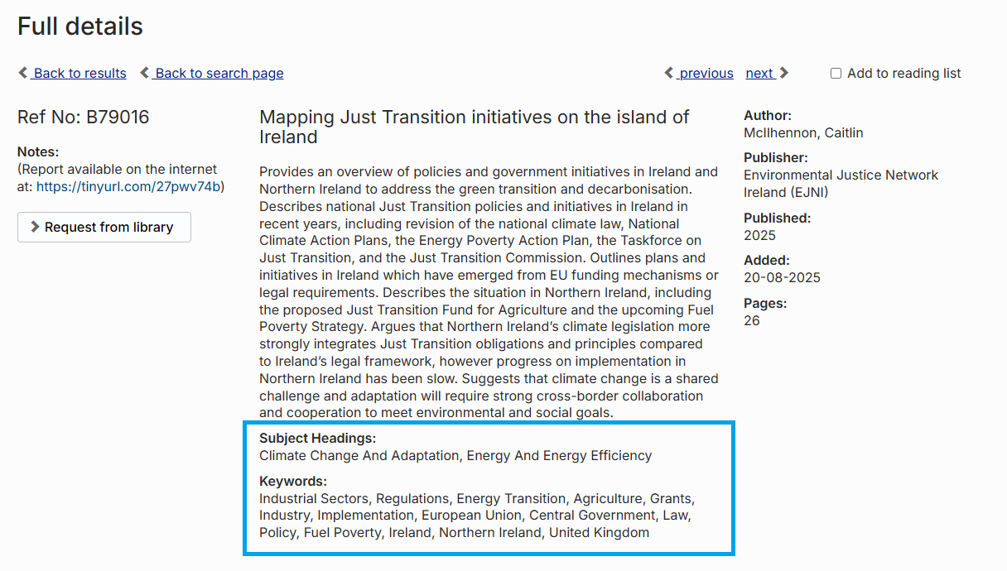
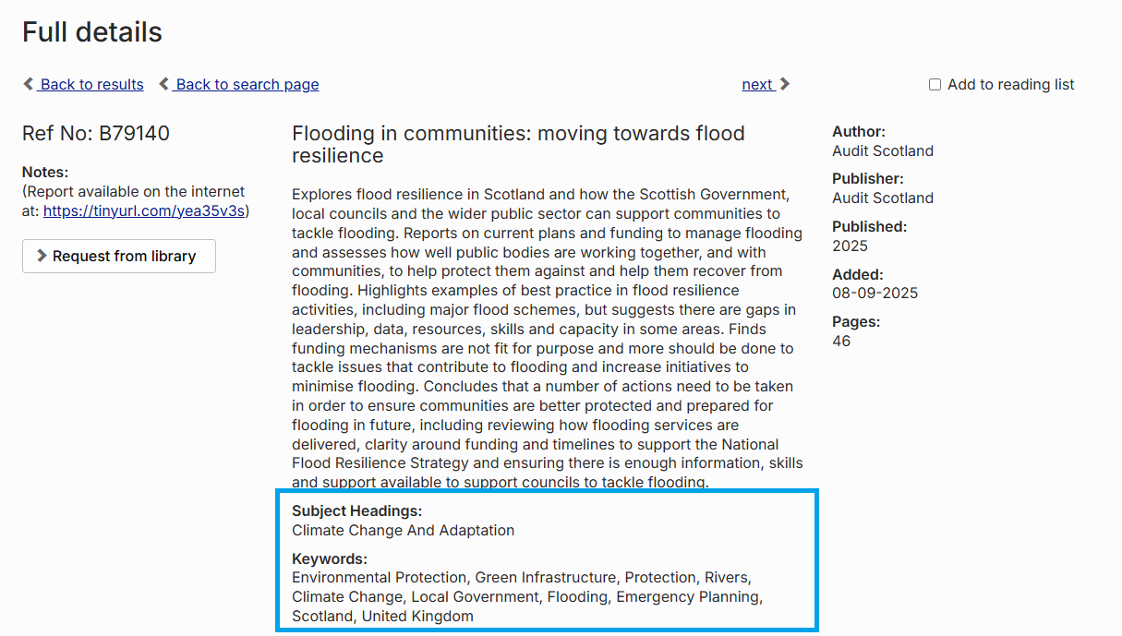
Keyword examples
Air pollution
Buildings
Children
Change of Use
Climate change
Drug abuse
Equalities
Economic Development
Green Infrastructure
Health
Homelessness
Land Use
Local Government
Mental Health
Multiple deprivation
Open Space
Older People
Poverty
Town and Country Planning
Young People

Slide 12
Boolean Searching
The Knowledge Exchange database is optimised for Boolean searching. A Boolean search is a query technique which will allow you to expand and limit your search
There are three basic Boolean search commands: AND, OR and NOT
  AND searches find all of the search terms (all terms must be present for the record to be returned)
  OR searches find one term or the other, or both (all, or either of the search terms can be present for the record to be returned)
  NOT eliminates items that contain the specified term (records that contain a specific terms are removed from the results)
If you're searching for a phrase rather than just a single word, you can group the words together with quotation marks e.g. “Active travel”
If you want to search for the stem of the word, to return multiple variations on a word, you can use an asterisk to truncate e.g. travel* would return results for travel; traveler; travelling; travelled etc.

Slide 13
Saving searches: bespoke alerts
The Knowledge Exchange database allows you to save any searches you run as alerts, so you can be notified when new material relating to your search terms is added to the collection.
You could run and save searches on:
  Topics of interest to you that we do not cover as part of our normal alert schedules, i.e topics not covered by our Topic Updates;
  Filtered versions of our topic updates i.e. housing, but focused on England only;
  Journal specific alerts to notify you when material is added from a particular journal you are interested in.
To save a search, simply run a search as normal on the website, then when your list of search results are returned, click the “save search as alert” link, which you can find below the search bar.
The website will ask you to give your alert a name and select the frequency of the alert schedule, and then you will be able to save your search.

Slide 14
Future proofing and horizon scanning
We are keen to hear any feedback or suggestions for improvements to the service, this could include our topic coverage, or additions to our book and journal collection.
We review our journal collection each year and add and remove subscriptions based on use and content published. If there is a journal that you would like to access which we do not subscribe to, or that we have elected not to-resubscribe to, get in touch to discuss with the team and we can put it forward for consideration at our next review.
Please bear us in mind when you are starting out on new projects, we can support with scoping existing literature to help identify research gaps and give you a good starting platform with available literature from which to start your programmes of work.
If you are able (sometimes due to confidentiality rules this isn’t always possible) you can send us strategy or planning documents for future projects to help us to ensure the collection reflects the priorities, you expect to be working on in future.

Slide 15

Summary of benefits
We provide the intelligence and support that researchers, practitioners and professionals need every day.
Learn from best practice case studies and examples of policy implementation from across the UK, Europe and internationally.
Information and intelligence to support improved decision making
Prevents information overload and helps provide wider context to your work in a convenient and efficient way.

Slide 16
More Information
https://www.idoxgroup.com/solutions/funding-information-services/
https://www.theknowledgeexchange.co.uk/
asktheresearchteam@idoxgroup.com

